Slide 1
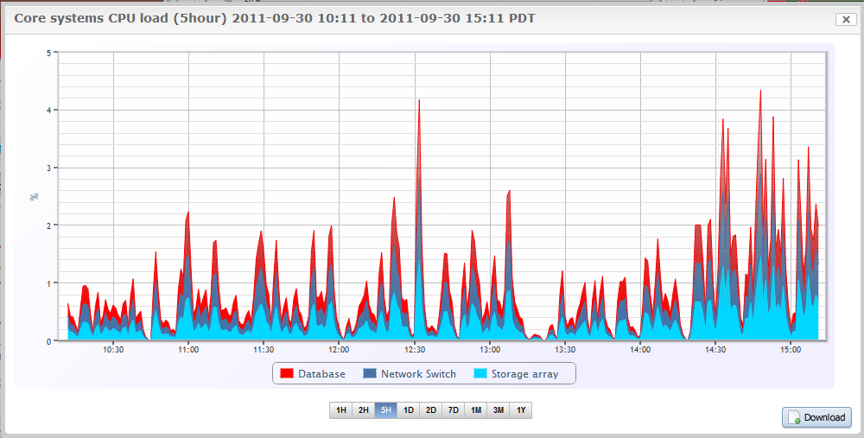
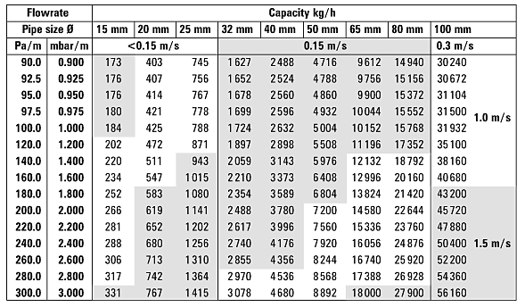
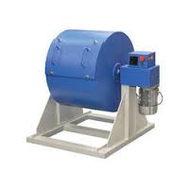
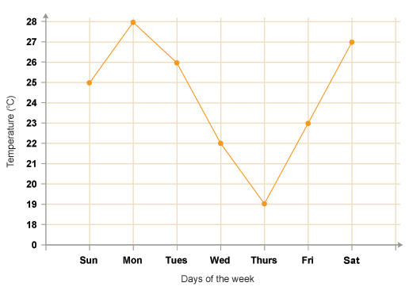
School of Mechanical Engineering
Industry Academia Networking Conclave
February 3-4, 2023
General Title format for the Poster Presentation - IANC 2023
Author¹, author², author^{3*}
¹ Department , Institution,² Department , Institution
*Corresponding author email
Motivation/ Introduction
Results
The page size of this poster template is A0 portrait (vertical) format. Do not change this page size, when printing.
You do not need to fill up the whole space allocated. Do not make your poster bigger than it is necessary just to fill that given size! The maximum size of the poster is given by the red outline. Do not exceed this, later you may remove the red bounding box
Importing / inserting files…
Images such as photographs, graphs, diagrams, logos, etc., can be added to the poster. To insert scanned images into your poster, go through the menus as follows: Insert / Picture / From File… then find the file on your computer, select it, and press OK.
The best type of image files to insert are JPEG or TIFF, PNG is the preferred format. Be aware of the image size you are importing. Check the dpi, it should be above 200
Do not use images from the website they will print very poorly.
Notes about graphs…For simple graphs use MS Excel, or do the graph directly in PowerPoint.
Graphs done in a scientific graphing programs (e.g.. Sigma Plot, Prism, SPSS, Statistica, Matlab) should be saved as JPEG or TIFF and them imported.
Captions to be set in Arial, italic, 22to 28 points, to the length of the column in case a figure takes more than 2/3 of column width.
Captions to be set in Arial, italic, 22 to 28 points, should be set above the table and centre aligned
Scope of the Project
How to use this poster template…
Simply highlight this text and replace it by typing in your own text, or copy and paste your text from a MS Word document or a PowerPoint slide presentation.
The body text / font size should be between 32-36 points. Calibri font. This is too small!
Keep body text left-aligned, and do not justify text! The colour of the text, title and poster background can be chosen from the four colours blue red green black
Methodology
Tips for making a successful poster…
Re-write your thesis into poster format i.e.. Simplify everything, avoid data overkill.
Headings of more than 6 words should be in upper and lower case, not all capitals.
NEVER DO WHOLE SENTENCES IN CAPITAL or underline to stress your point, use bold characters instead.
When laying out your poster leave space around you text. Don’t overcrowd your poster. Try using photographs or coloured graphs. Avoid long numerical tables.
Spell check and get someone else to proof-read.
Ensure that the graphs are labelled. The labels should be the same as 7 to 9 points size in the poster. Graphs are best posted as high quality images to prevent them from being altered.
Equations should be written using the Microsoft Equation Editor. An example is given below.
$$\frac{σ_{max}}{MOR}=1−β\left(1−R_{max}\int_{0}^{2π}{\sin{x}dx}\right)$$
Equations should use the same font size as the text. It should be centre aligned and the variables used should be obvious to the reader.
Captions to be set in Arial, italic, Left aligned if it refers to a figure on its left. Caption starts right at the top edge of the picture (graph or photo). Try using photographs or coloured graphs. Avoid long numerical tables. Spell check and get someone else to proof-read
Captions to be set in Arial, italic, between 22 to 28 points. Right aligned if it refers to a figure on its Right. Caption starts right at the top edge of the picture (graph or photo).
Conclusion/ Summary
Brief summary of what you discovered based on results
Indicate and explain whether or not the data supports your hypothesis
Give directions for future work in this area.
Each of the areas can be expanded as per requirement. Please use only a two columns to make it visually appealing.
Contact Details
Student(s)_email_id@vitstudent.ac.in
Acknowledgments/ References / Project Outcomes
The body text / font size should between 32-36 points.

