Slide 1

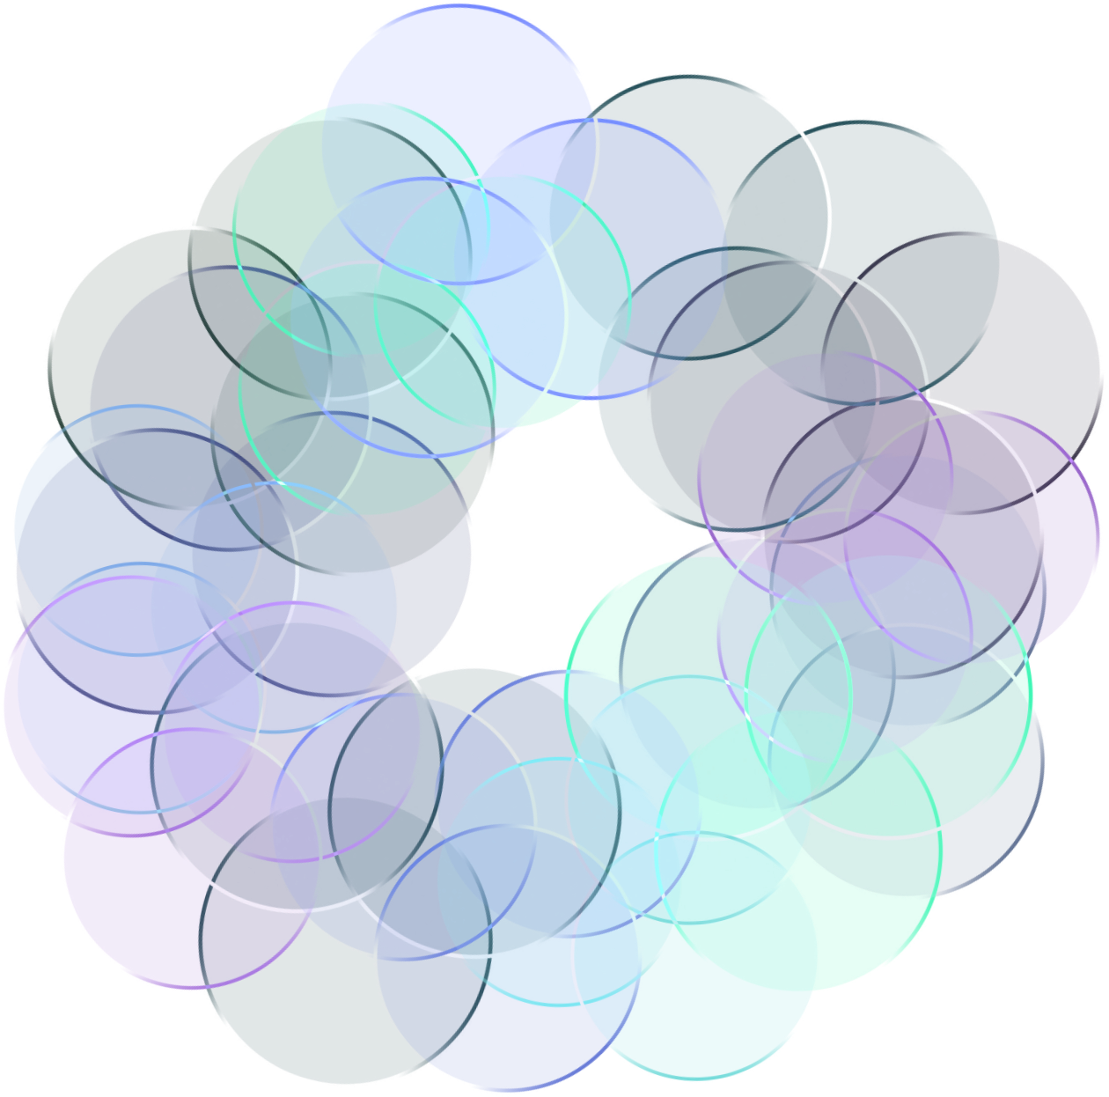
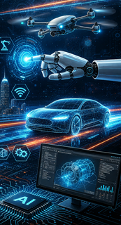

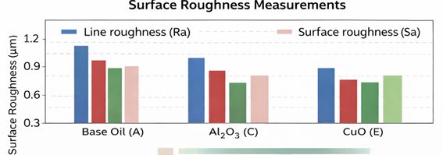
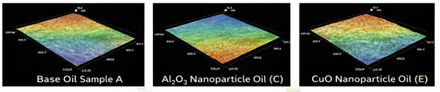
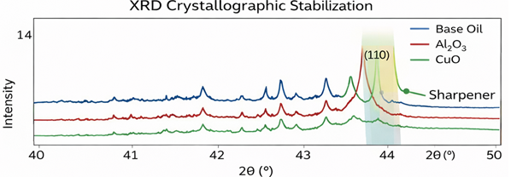
School of Mechanical Engineering
INDUSTRY ACADEMIA NETWORKING CONCLAVE (IANC) 2026
March 24, 2026
Theme: Reimagining Mechanical Engineering in the Digital Era
Student Name(s), Guide Name | email@vitstudent.ac.in
Project Title - AAAAAAAAAAAAAAAAAAAAAAAAAAAAAAAAAA
INTRODUCTION
The page size of this poster template is A0 portrait (vertical) format. Do not change this page size, when printing.
You do not need to fill up the whole space allocated. Do not make your poster bigger than it is necessary just to fill that given size!
The maximum size of the poster is given by the red outline. Do not exceed this, later you may remove the red bounding box
METHODOLOGY
The page size of this poster template is A0 portrait (vertical) format. Do not change this page size, when printing.
Caption starts right at the top edge of the picture (graph or photo). Try using photographs or coloured graphs. Avoid long numerical tables. Spell check and get someone else to proof-read
You do not need to fill up the whole space allocated. Do not make your poster bigger than it is necessary just to fill that given size!
Figures / Pictures / Graphs
RESULTS & DISCUSSION
CONCLUSIONS
Importing / inserting files…
Images such as photographs, graphs, diagrams, logos, etc., can be added to the poster. To insert scanned images into your poster, go through the menus as follows: Insert / Picture / From File… then find the file on your computer, select it, and press OK.
The best type of image files to insert are JPEG or TIFF, PNG is the preferred format. Be aware of the image size you are importing. Check the dpi, it should be above 200
Do not use images from the website they will print very poorly.
Notes about graphs…For simple graphs use MS Excel, or do the graph directly in PowerPoint.
Graphs done in a scientific graphing programs (e.g.. Sigma Plot, Prism, SPSS, Statistica, Matlab) should be saved as JPEG or TIFF and them imported.
Brief summary of what you discovered based on results
Indicate and explain whether or not the data supports your hypothesis
Give directions for future work in this area.
Each of the areas can be expanded as per requirement. Please use only a two columns to make it visually appealing.
ACKNOWLEDGEMENTS / REFERENCES | Contact: email@vitstudent.ac.in

